Slide 1

Exit Counseling for Graduating Students

Slide 2
Why do I need to do exit counseling?
Federal regulations require all federal student loan borrowers to complete an exit loan counseling session shortly before graduating
  Failure to complete exit counseling can result in a hold on records
Exit counseling provides information on how to effectively manage student loan repayment
There are 5 parts to Federal Student Aid exit counseling:
  Understand Your Loans- displays your loan balance
  Plan to Repay- tools to handle repayment
  Avoid Default- understand how to avoid delinquency and default
  Finances: A Priority- how to develop a sound financial plan
  Repayment Information- collects info about you, references, and preferred repayment plan

Slide 3
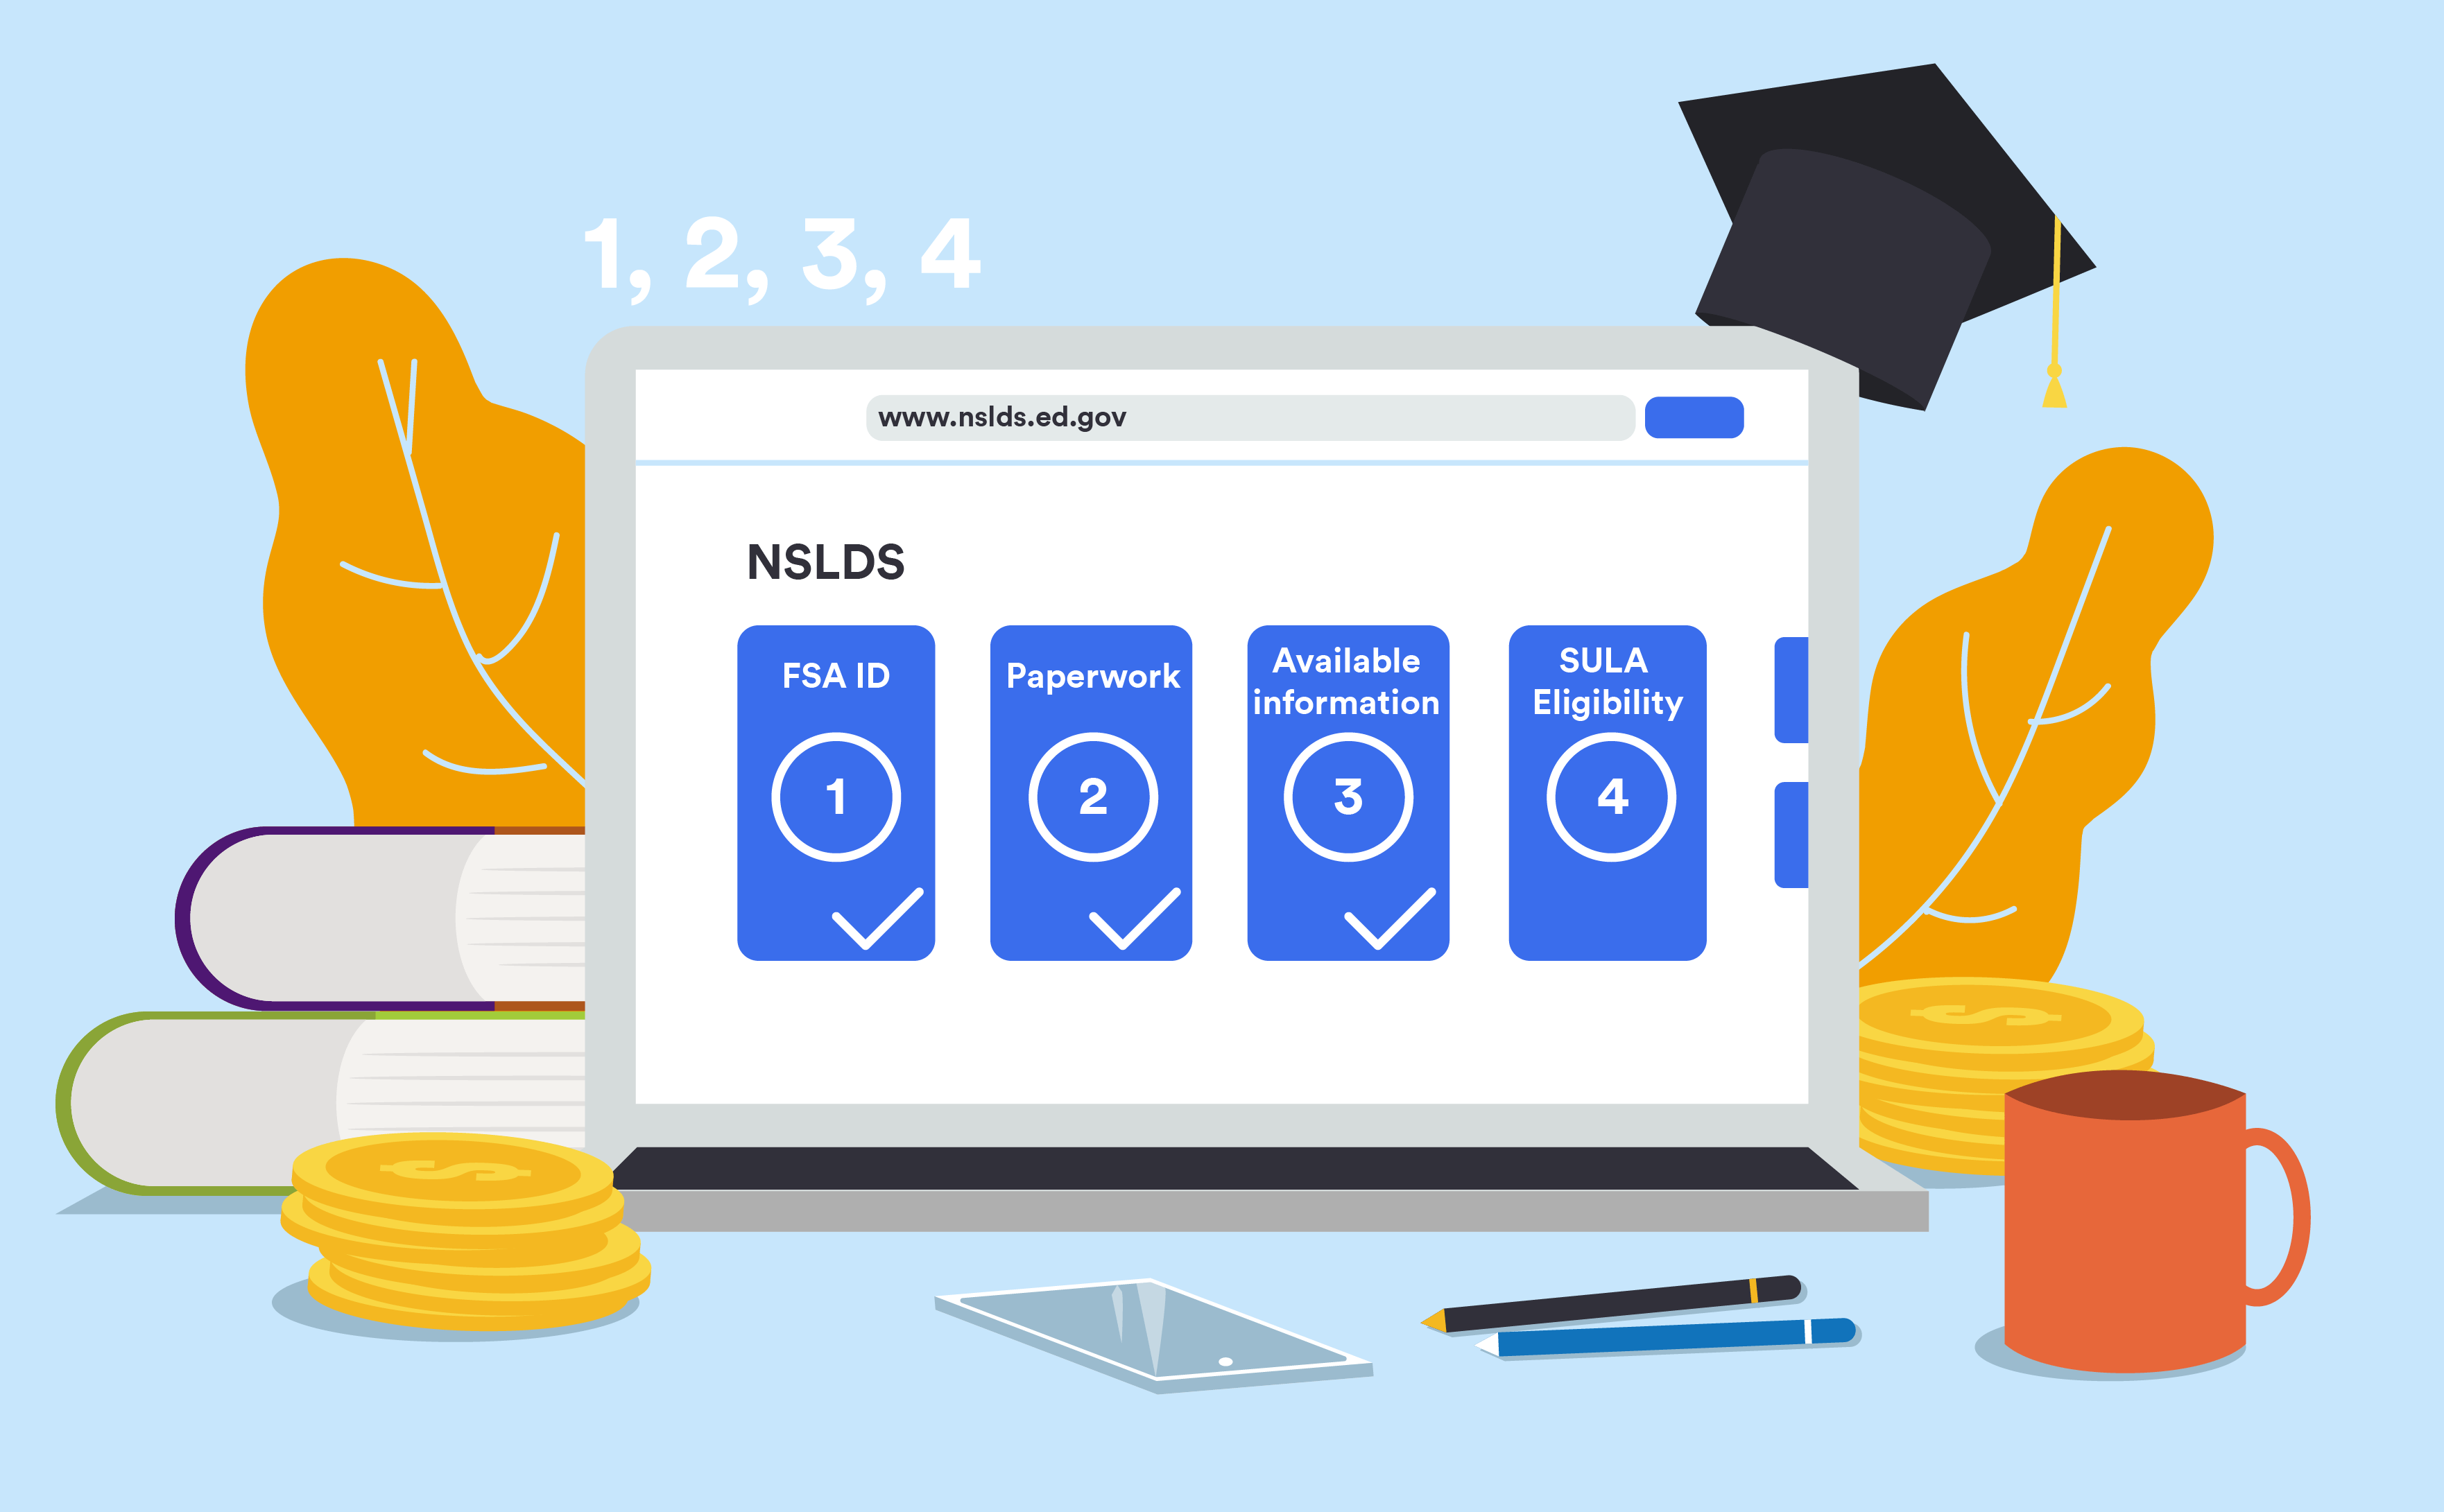
National Student Loan Data System (NSLDS) – StudentAid.gov
StudentAid.gov is a federal website that utilizes your FSA ID (FAFSA login information) to display all your federal student loan information
  StudentAid.gov does not display information about private student loans. For that information you will need to contact your private loan lender
  Parent PLUS loan information will appear in your parents’ StudentAid.gov account, not yours

Slide 4
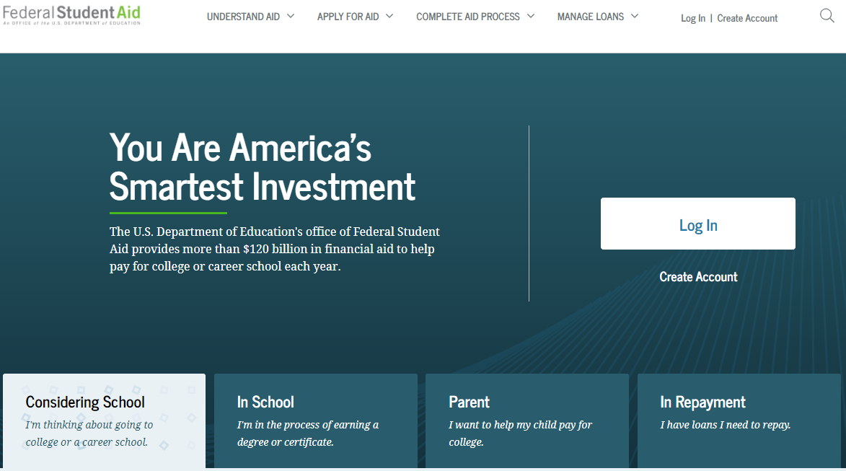
National Student Loan Data System (NSLDS) – StudentAid.gov
How to navigate Studentaid.gov:
  Visit studentaid.gov and click on the “Log In” box.
  Log on using your FSA ID
  Under your profile, you may click on “Managing Loans” to access your federal loan information.
  You can view the loan amounts, loan types, and servicer information on this page.

Slide 5
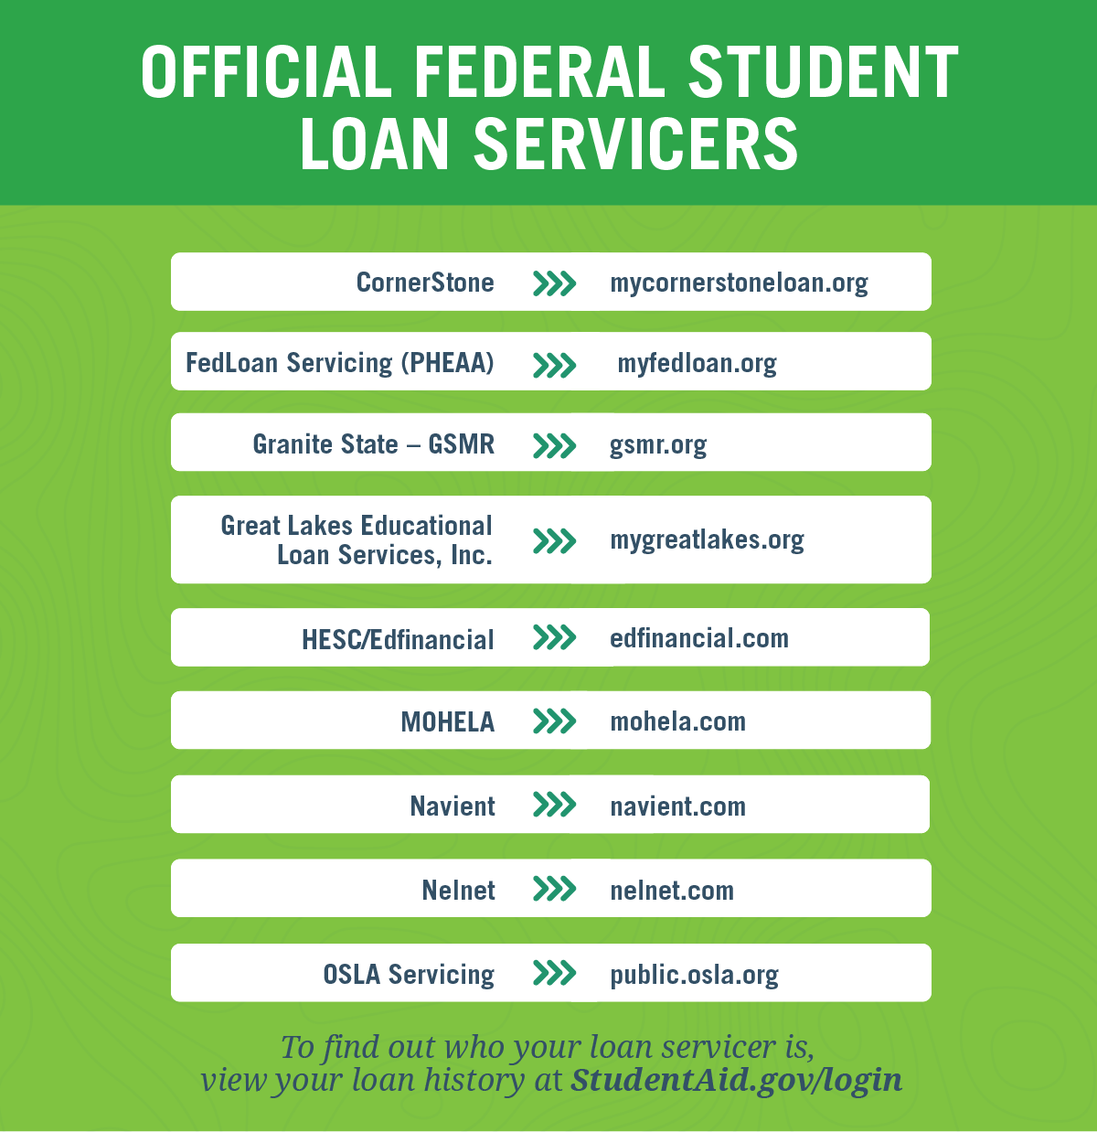
Know Who Your Servicer Is
A loan servicer is a company that handles the billing and other services on your federal student loan
  It’s possible your student loan could be sold to a different servicer (ex. Nelnet recently acquired Great Lakes)
Contact your servicer when you:
  Need to update your contact information
  Have questions about your loan
  Want to change repayment plans
  Have trouble making your monthly federal student loan payment

Slide 6
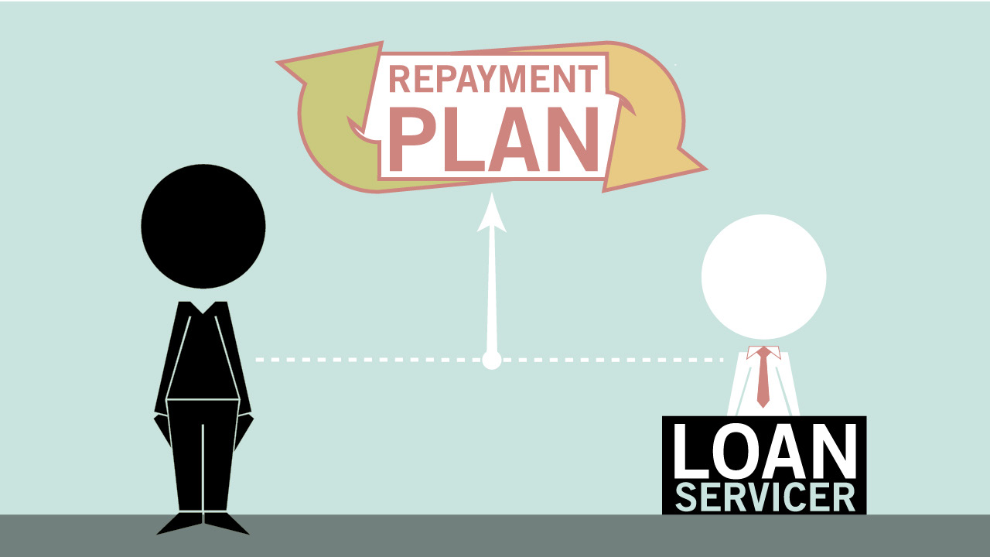
Know Who Your Servicer Is
When you complete exit counseling online, your contact information will automatically be provided to your loan servicer
  You are required to notify your loan servicer of any changes to your contact information (address, email, phone number) after you leave school
For information on loan servicers, including their contact information, visit StudentAid.gov/servicer

Slide 7
Important Terms
Subsidized Direct Loan
  Available to undergraduate students with financial need
  The U.S. Department of Education pays the interest while in school
Unsubsidized Direct Loan
  There is no requirement to demonstrate financial need
  Borrower is responsible for the interest while in school
Principal
  The total sum of money borrowed plus any interest that has been capitalized
Accrued Interest
  Interest that has accumulated
  Interest on Direct Loans accrues daily
Capitalized Interest
  The addition of unpaid interest to the principal balance of a loan
Grace Period
  Period of time after you graduate when you are not required to make payments
  You can make payments during your grace period to reduce the amount of capitalized interest before you enter repayment

Slide 8
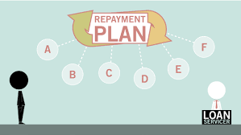
Repayment options
When am I required to begin making payments?
  6 months after you graduate for most federal student loans
Sign up for automatic payments- you might even receive an interest rate deduction on your loan!
Know whether you are eligible for loan forgiveness based on your employer or your job
One size does not fit all! Find a repayment plan that fits your needs by using the “Loan Simulator” on StudentAid.gov
  Standard
  Graduated
  Pay As You Earn
  Revised Pay As You Earn
  Income-Based Repayment (IBR)
  Extended (Fixed or Graduated)
  Income-Contingent Repayment
Remember, you can change your repayment plan at any time by contacting your loan servicer

Slide 9
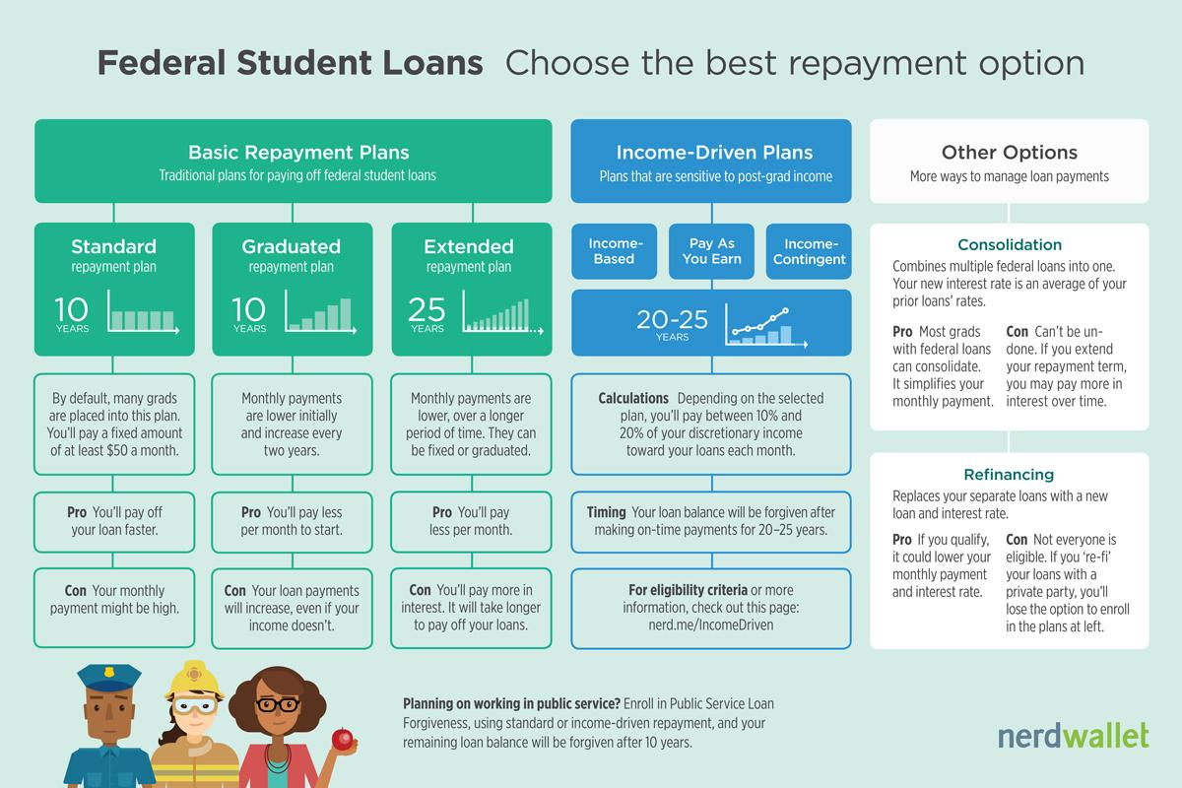

Slide 10

Managing Your Money
Do you have a budget?
  Following a budget helps you weigh your income with your expenses
  Tips on how to stick with a budget:
    Learn to say “no”
    Avoid overspending on food
    Be smart with credit cards
Are you responsible with credit cards?
  Avoid credit card debt at all costs
  Do not use all your available credit
    You want to keep your “credit utilization” low
  Pay your balance in full every month

Slide 11
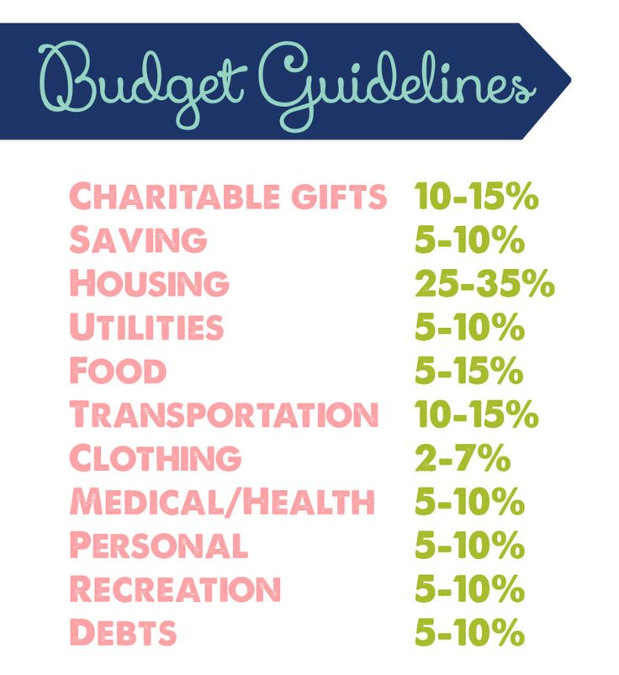
Simple steps to create a budget
Know how much money you have coming in
Track your expenses for one month
  Figure out the necessities versus things you want
  Prioritize your spending
    Groceries versus Starbucks
    Rent versus new shoes
Adjust spending as needed
Be realistic and give it time
Don’t forget to include savings and retirement contributions

Slide 12
Budgeting in the palm of your hand
Mvelopes
  Sync to accounts
  Budget first
  Envelope second
BillGuard
  Track spending habits
  Fraud protection
  Swipe right
Pocket Expense
  Visual spending report
  Add multiple accounts
Mint.com
  Spending & saving
  Budget & earnings
  401(k), IRA, savings
The Birdy
  Reply to email
  Pie chart
EveryDollar
  Budgetting tool
  Link multiple accounts

Slide 13
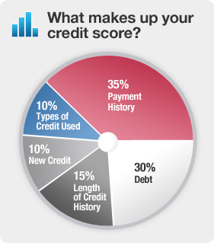
What is a credit score/report?
Your credit score is what lenders use to determine whether or not to extend credit to you
  Think of your credit score like your GPA
Your credit report summarizes your existing and past lines of credit
  Think of your credit report like your transcript
Have you checked your credit report?
  Everyone can check their credit report once every 12 months, free of charge at Annualcreditreport.com
  Don’t request all 3 at the same time
Tips for improving your credit score:
  Pay your bills on time and pay off debt
  Keep credit card balances low and don’t sign up for any more

Slide 14
Ways Student Loans Impact Credit
Student loans are reported within 90 days of disbursement to the 3 major credit bureaus
  Until the borrower goes into repayment, the status is reported as “open/in good standing” on your credit report
  Once a borrower enters repayment, the monthly payment amount is reported
Late payments can negatively impact credit
A student loan is considered delinquent 30 days after the due date
  Delinquent status will remain on your credit report for 7 years
  Loan servicers do not wait around for the borrower to reach out to them
Your credit report indicates your repayment period and should include all your education loans

Slide 15
Having a difficult time making payments?
Avoid delinquency- contact your loan servicer BEFORE you miss a payment on your federal student loan
  You will default if you have not made a payment in 270 days (which can result in serious legal consequences)
1. Consider switching repayment plans
  Don’t forget to ask about plans based on your income or loan forgiveness options
2. Consolidation- the result is a single monthly payment instead of multiple payments to different servicers
  This could lower your payments but increase the period of time you have to repay (costing more in the long run)
3. Request a deferment or forbearance to temporarily postpone your payments
  Deferment= interest does not accrue Forbearance= interest will continue to accrue
Deferments and forbearance do not negatively impact your credit report

Slide 16
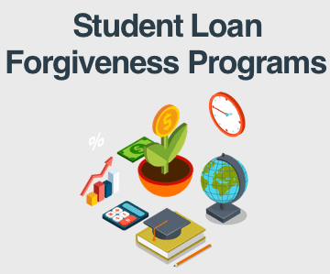
Loan Forgiveness Options
Public Service Loan Forgiveness (PSLF)
  May qualify after making 120 qualifying monthly payments while working full time for a qualifying employer
    Government organization
    Peace Corps or AmeriCorps
    A not-for-profit, tax exempt organization
    A private, not-for-profit organization
Teacher Loan Forgiveness
  Teach full-time for 5 complete, consecutive years in certain schools/agencies that serve low-income families
Loan Supplements and Educational Awards
  AmeriCorps
  Peace Corps
  TEACH for America

Slide 17
What do I need in order to complete exit counseling?
Go to StudentAid.gov to complete exit counseling
It will take 20-30 minutes and must be completed in a single session
Know the following information in order to complete exit counseling:
  FSA ID (FAFSA login)
  Social Security Number
  Driver’s License number
  Contact information for next of kin (nearest relative)
  Contact information for at least two references
  Future employer address/phone
Note: You may not list the same person as both your Next of Kin and a Reference

Slide 18
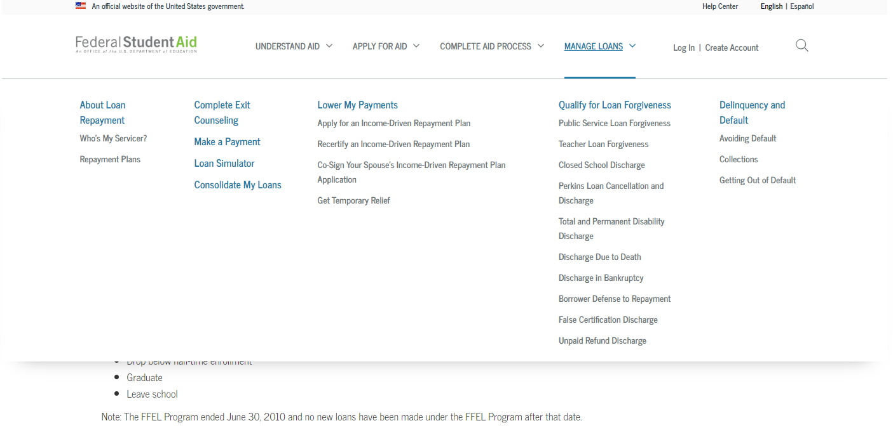
Studentaid.gov: Exit Counseling

Slide 19
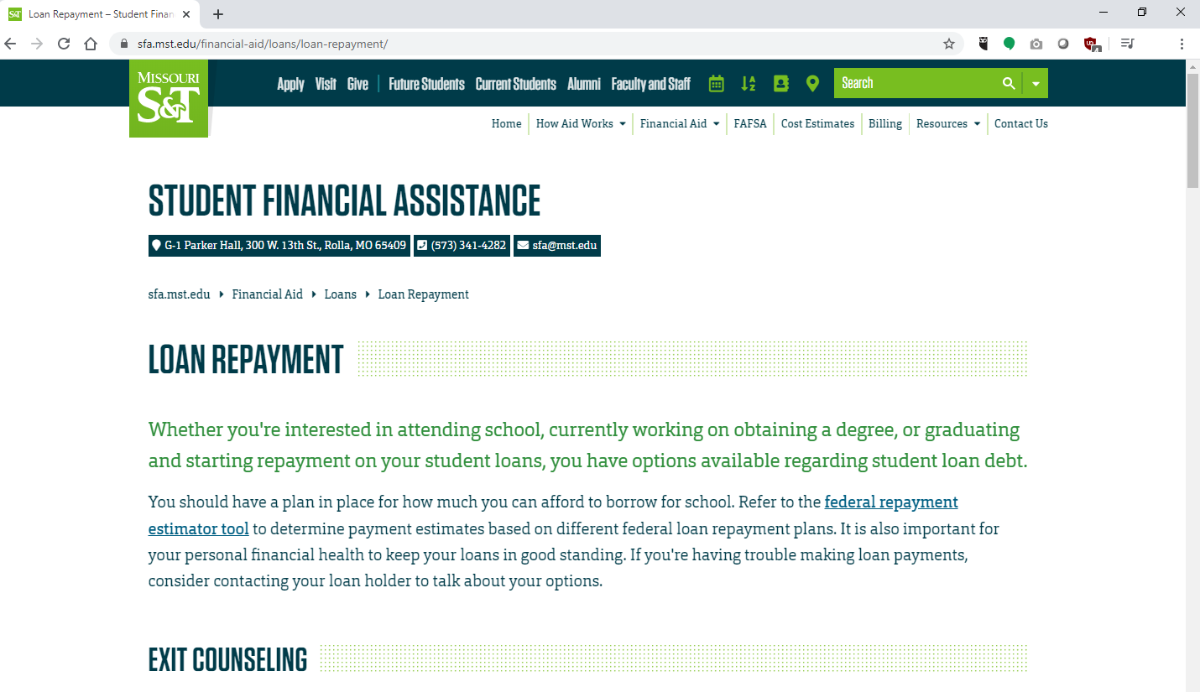
SFA.mst.edu: Repaying Student Loans
sfa.mst.edu/financial-aid/loans/loan-repayment/
Go to sfa.mst.edu
Select Financial Aid and Loans to get to the loans page
“Repay your student loans” will be in the right hand side to take to you this page.
The Exit Counseling portion will have a copy of this presentation, and additional resources for exit counseling

Slide 20
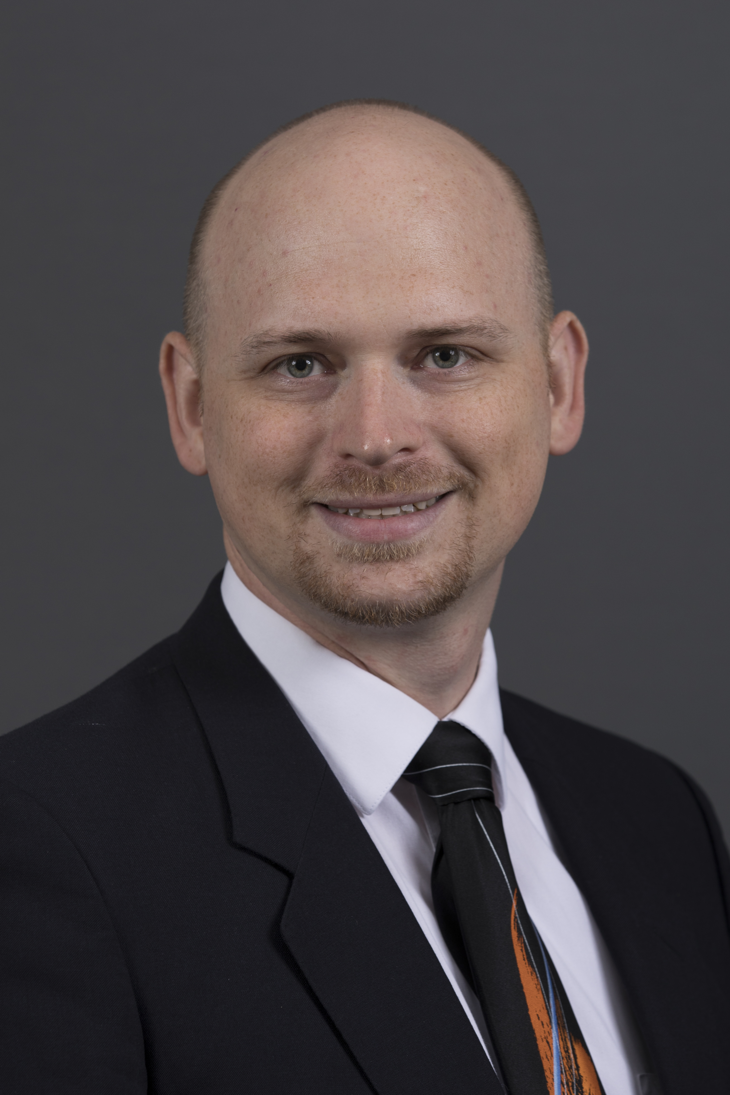

Contact information
Student Financial Assistance
sfa.mst.edu
sfa@mst.edu
573-341-4282
John Cook
Manager
jacook@mst.edu

Slide 21

Congratulations!!!

